Slide 1
Business Development Projects - Quarterly Report
3 October 2022

Slide 2
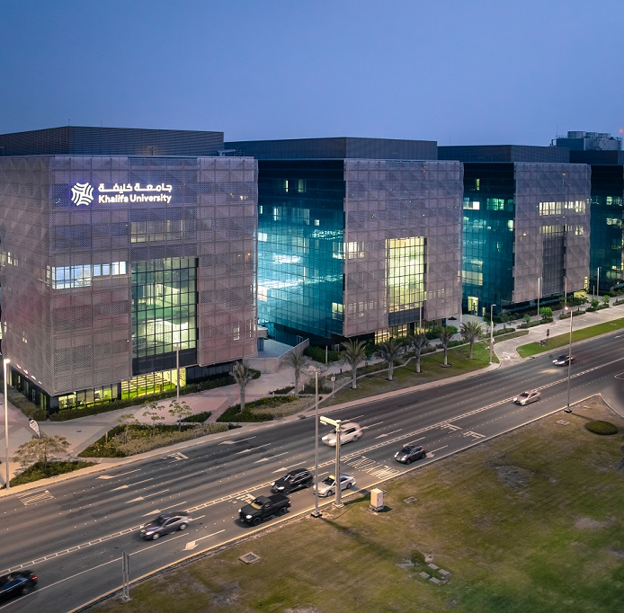
Introduction
Scope of BD :- To improve an organization’s market position and achieve financial growth. defines long-term organizational strategic goals, builds key customer relationships, identifies business opportunities, negotiates and closes business deals and maintains extensive knowledge of current market conditions.

Slide 3
A- Business Development - Core University Operation

Slide 4
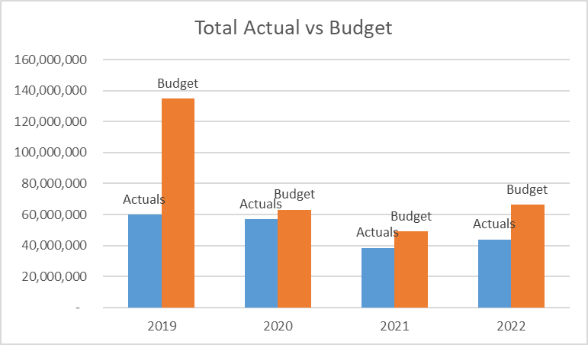
KU 2022 Revenue Actual vs Budget
*
* Actuals up to the end of Sep 2022.

Slide 5
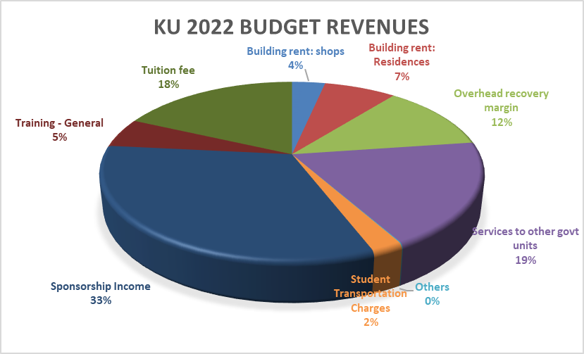
KU 2022 Revenue Budget

Slide 6
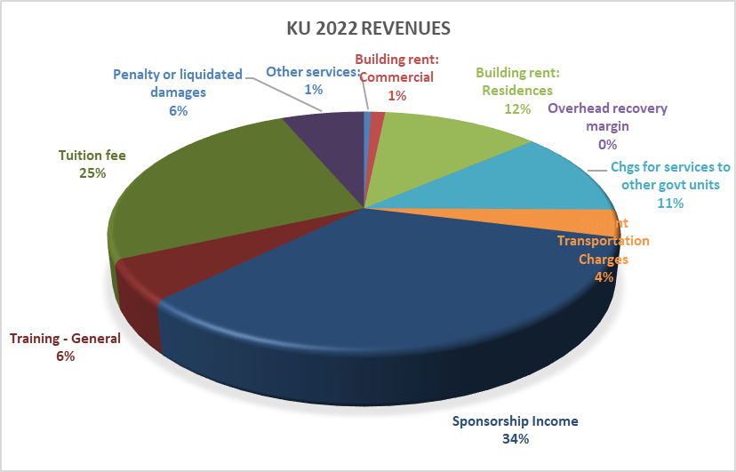
KU 2022 Revenue Actuals

Slide 7
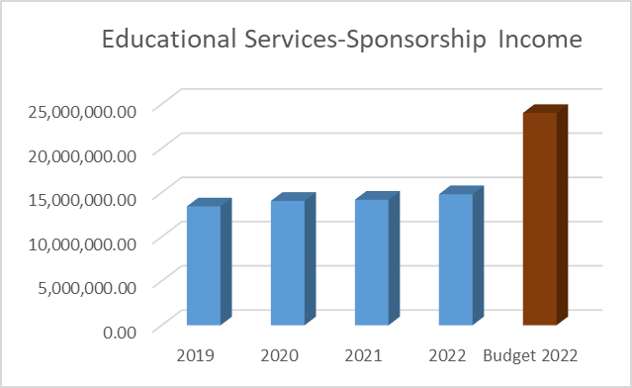
Revenue Channels
Achievements:-
1- Maintain the revenue level high in the last 5 years.
2- Develop new policies to attract new sponsors.
Challenges:-
1- Loosing many major sponsors such as ICT and GHQ.
2- Revenue correlated to the governments budget trends.
3- Need to attract the private sectors.

Slide 8
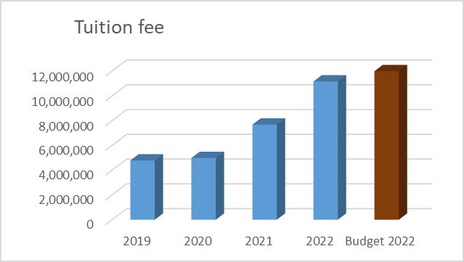
Revenue Channels
Achievements:-
1- Established a new scholarship program for expat.
2- Materially revenues increase from Tuition in the last 4 years.
Challenges:-
1- Need to keep adding new scholarship programs to attract the GCC students.
2- Need excessive marketing campaigns.
3- Students reporting systems in KU.

Slide 9
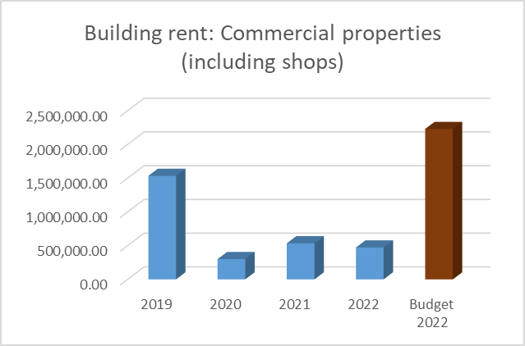
Revenue Channels
Achievements:-
1- Increase the rental areas in KU with the supports of Facilities department..
2- Start a new program of donation for Ku facilities.
Challenges:-
1- Automation of the outlets systems in KU.
2- Need more coordination with KU department to support the rental activities.

Slide 10
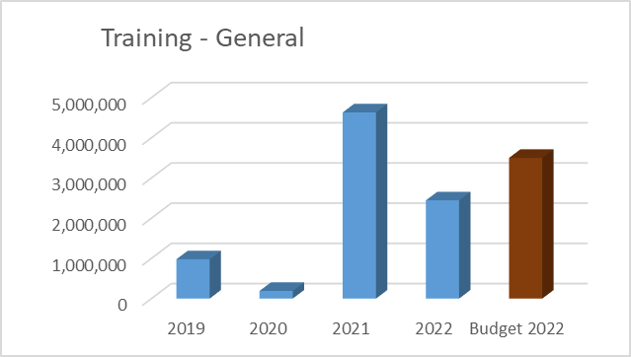
Revenue Channels
Achievements:-
1- Establishing a continuing education center in KU.
2- Materially increased the revenues from this channel.
Challenges:-
1- still in low operating level, looking to get a new clients and operate in full capacity.
2- Balancing between business and faculties efforts.

Slide 11
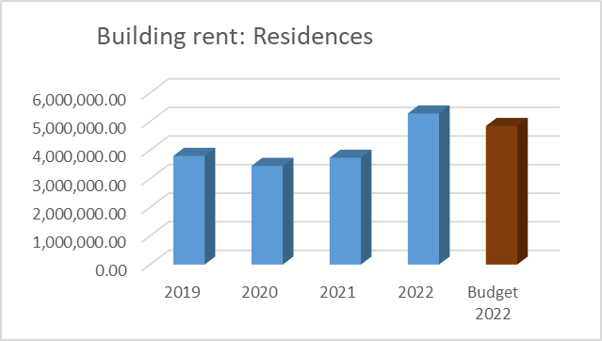
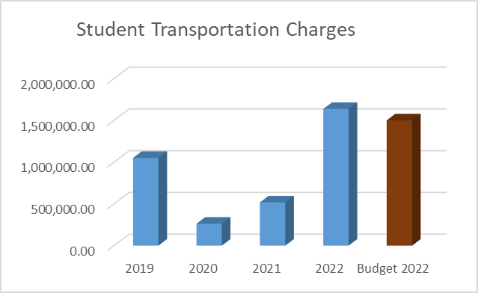
Revenue Channels

Slide 12
Academic Projects
1
Project Name: Increase revenue form UG Scholarship
Project involved:- Student Services /BD
Project briefing:- Establish new scholarships and increase marketing efforts.
Project time frame: Continue
Project updates: in progress
Project Name: Increase revenue form PS Scholarship
Project involved:- PG Studies/BD
Project briefing:- Establish new scholarships and increase marketing efforts.
Project time frame: Continue
Project updates: in progress
Project Name: Increase revenue form Sponsorship.
Project involved:- Student Services /BD
Project briefing:- Establish new scholarships and increase marketing efforts.
Project time frame: Continue
Project updates: in progress

Slide 13
Academic Projects
Project Name: Establish the new GCC scholarship.
Project involved: Students Services
Project briefing:- To establish a new scholarship named GCC, to attract regional students.
Project time frame:2023
Project updates: visits done by students services to some of GCC countries and awaiting the kick-off meeting
Project Name: Develop reporting on students related revenues.
Project involved departments: Student Services / BD
Project briefing:- To provide more useful reports about the current scholarship/sponsorship data
Project time frame: Oct 2022
Project updates: under review by students services.

Slide 14
Continuing Education
2
Project Name: Prepare a training proposal to MOE.
Project involved departments: Artificial intelligence
Project briefing:- Awareness training program for Artificial intelligence to all MOE employees
Project time frame: Dec 2022
Project Name: Prepare a training proposal to AD Airport.
Project involved: Aerospace / Academic departments
Project briefing:- collaboration in training area
Project time frame: Nov 2022
Project updates: Arranging for the collaboration agreement.
Project Name: Prepare collaboration proposal to Korean Nuclear company.
Project involved: Nuclear Depart
Project briefing:- collaboration in training area
Project time frame: Dec 2022
Project updates: Awaiting the Korean company response for the selected training courses.

Slide 15
Continuing Education
Project Name: Prepare a training proposal /System dynamic program.
Project involved departments: Industrial Application
Project briefing:- Acquiring a new training franchise from Russian company.
Project time frame: Jan 2023
Project Name: Prepare a training to Clinical program to SEHA.
Project involved departments: Medical School
Project briefing:- SEHA Clinical Research Program Cohort 1 started in April 2021 it will end this October 2022 with 40 graduates after the successful launching of 1st batch. Cohort 2 started in October 2021, will end in May 2023 with 40 students.
Project time frame: continue
Project updates: Third stage will start in Nov 2022.

Slide 16
Continuing Education
Project Name: Prepare a training program to ADIA (bridge program).
Project involved :- Academic Departments
Project briefing:- The Bridge Program Python and Math have 6 students in both programs started in 06 June ends 22 July. The 5 Students admitted to KU Master program. One student failed in Math,thus he cannot enroll in the master program.
Project time frame: under progress
Project updates: Continue
Project Name: Finalizing collaboration agreement with AD Police.
Project involved departments: Continues Education program & BDU.
Project time frame: Under Progress.
Project updates: The agreement was activated, meetings between the two parties. KU was visited by the delegation of officers (Future leaders), on going coordination to meet with Major General Thani Al-Shamsi, leader of Saif bin Zayed Academy. To start implementing the MOU.

Slide 17
Continuing Education
Project Name: Start courses preparation with Coursera.
Project involved : Academic Departments
Project briefing:- Partnership between KU and Coursera, to stimulate KU courses and increase revenues
Project time frame: Dec 2022
Project updates: The final contract signed, will receive the first funding within 3 weeks, and project will start.
Project Name: Establish the Cyber academy in KU.
Project involved department: Artificial intelligence
Briefing: to establish an academy for cyber security in coordination with Leonardo academy from Italy, which can be a unique academy in UAE.
Project time frame:. Mar 2023
Project updates:. Still in the budgeting and contracting stage, to agree on partnership details.

Slide 18
Commercial activities
3
Project Name: Finalize Laboratories website and operation model.
Project involved: Laboratories Department
Project briefing:- Commercialization of KU laboratories.
Project time frame:. Dec 2022
Project updates:. Awaiting Laboratories department to provide the website contents, many opportunities to use KU lab in pipeline.
Project Name: Smart card project for students(Extra miles)
Project involved departments: Students Services and IT.
Project time frame: 4 months expected to be lunched Jan. 2023
Project Briefing: to establish student card system that add value to all KU students.
Project updates: Reviewed with Student services senior management, they asked to review first with IT to check similar system was used before in PI.

Slide 19
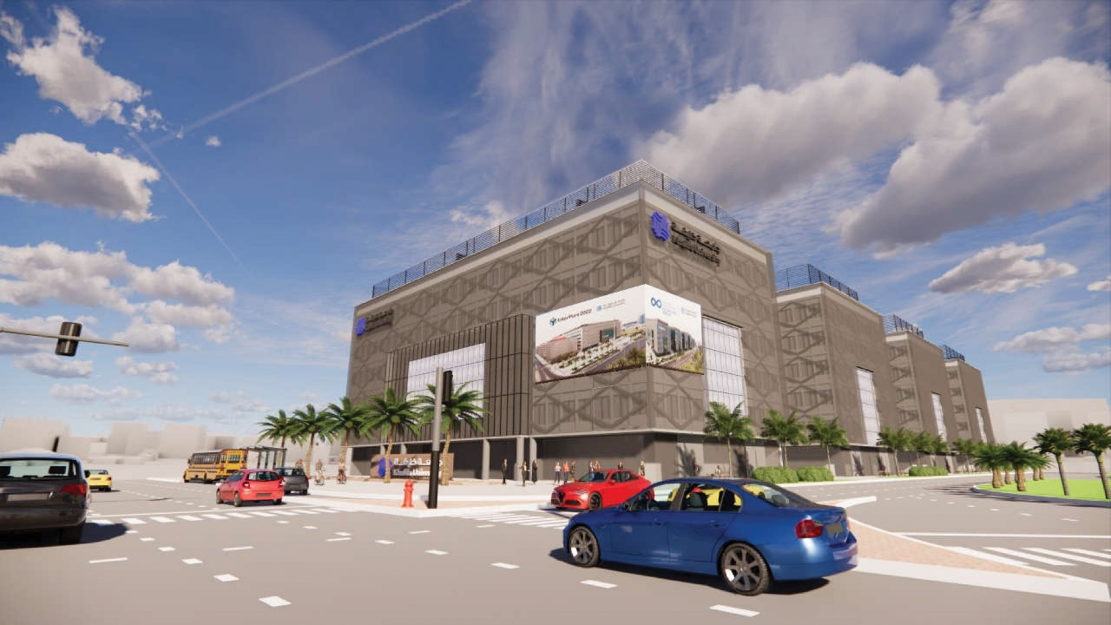
Commercial activities
Project Name: Outdoor Advertisement Screens
Project involved departments: Communications /Project time frame: 6 months.
Project briefing: to install huge outdoor screen to help in community awareness and generate revenue.
Project Timeframe: Jan 2023
Pending points: to meet our management to approve the concept.

Slide 20
Commercial activities
Project Name: The Nursery
Project involved departments: Facilities,
briefing : to establish a nursery that help KU community.
Project time frame: expected first week of Sep.2022
Project updates: in the final stage of ADEC approval and should start location mobilization soon.
Project Name: Souvenirs shop.
Project involved: Communications.
Project briefing:- Having a Souvenirs shop in KU to increase KU branding and increase other revenues.
Project time frame: Dec 2022.
Project updates: Communication mentioned it is under progress.
Project Name: Approve 2022 venue rental rates.
Project involved: KU management
Project briefing:- Update the venue rental rates for the year 2022
Project time frame: Jan 2023
Project updates: awaiting the new valuator to finish his work.

Slide 21
B- Business Development - KUEC

Slide 22
KU Endowment history and investment
1
Project Name: Growth the net value of KU Endowment..
Project involved departments: BD / Treasury/ KUEC.
Project briefing:- by investing the endowment fund and grow its value.
Project time frame: continuing project
Project updates: under process.
Project amount: AED 105 million
Endowment funding history:
Current status:
With Black-Rock as investor (JP Morgan as bank manager) AED 99 m
(expect earning: 5% annually)
AED 6 m allocated to ventures
Current profitability: unrealized losses (USD 1,478,730.06) as of 31 July 2022

Slide 23
KU Endowment frame work for future funding
Project Name: New Endowment Frame work
Project involved departments: BD
Briefing: to establish a new endowment business frame work and policy that organize the donations and endowment operation.
Project time frame: expected first week of Dec.2022
Project updates: Proposed new business framework done, now looking for management approval through Leadership committee.
Amount: not defined (to maximize the fund)

Slide 24
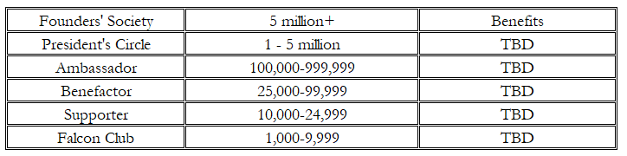
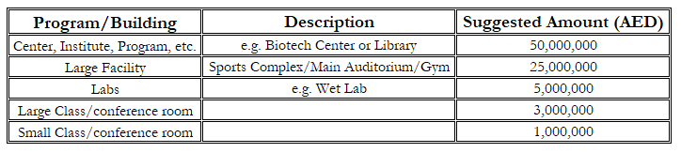
KU Endowment frame work for future funding
Financial Goal
Timeline Goal
Investment Risks and Returns
7%-8% Avg. Annual Returns
Inflation and Losses
Spending Policy
4%-5% of principle amount
Fundraising Goal Amount?
5 Years
Donor Relations
Naming Opportunities
AED 100mm
X 4%
= AED 4 million
AED 500mm
X 4%
= AED 20 million
AED 1Bn
X 4%
= AED 40 million

Slide 25
Ankabut
2
Project Name: ANKABUT company project.
Project involved departments: Anakbut
Project briefing:- To establish a state-of-art IT company in UAE
Project time frame: Oct 2024
Project updates: The company licensed recently, currently in the transition period from current non-for- profit to the commercial model.
Capital: around AED 45 million
RoI : expected to generate average of 20-25 %
Challenges: Set up the company HR and operations.
Pending work: at beginning

Slide 26
Summary of revenue and expenditures actual/projection for 10 years (from 2017 to 2026)
AED million
Notes:
The net profit in Y2023 would be reduced from AED 5.5 m to AED 2.8 m if the lowest conservative scenario for connectivity is selected and the lowest scenario for IT managed services while it would increase to AED 12.2 m if the best optimistic scenario is achieved.
There is an increase in total expenditure and a drop in net profit in Y2023 because of additional expenses related to carve out (around AED 12 million i.e. 7.8 + 4.2).
Depreciation remains consistent because no additional capital is expected to be added in the coming few years.
Increase in “other operating expenses” because of increase in cloud services thus the related expenses.
International link cost AED 2.4 million is assumed to be stopped wef 2023.

Slide 27
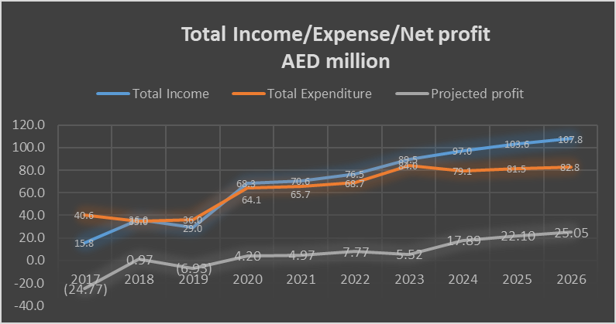

Slide 28
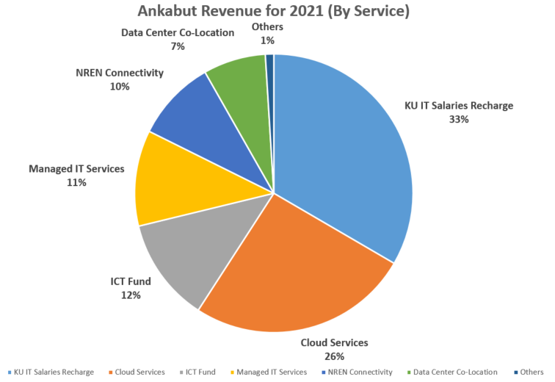
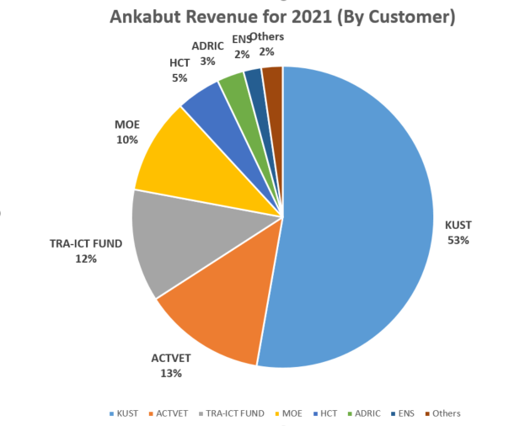
Revenue Streams
Analysis of total revenue AED 70.7 million for Y2021

Slide 29
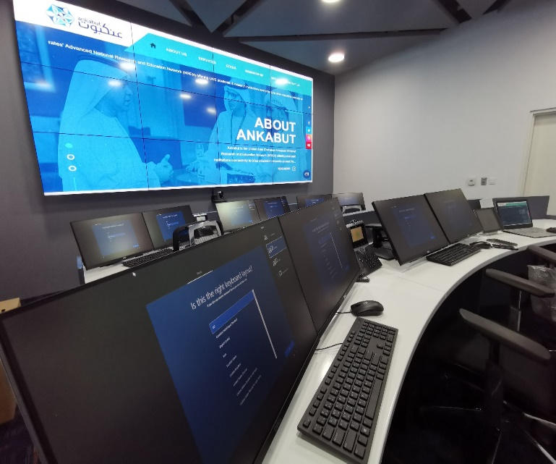
Ankabut Curve Out -Executive Summary
The objective of the transaction is to curve out Ankabut from Khalifa University into stand alone commercial entity. This will enable Ankabut to monetize its capabilities by expanding its client base.
As part of this transaction consultant “PwC” has been recruited to develop a curve out blue print to define the detailed operational and separation perimeter, and establish the Pro-forma financials of the stand alone business upon curve out.
The main findings of PwC consultancy :
Curve out complexity : Low /Moderate .
Viability of stand- alone business: Viable and EBITDA is positive.
Business potential : 20% in UAE and wider in MENA.
Time required: 6 Months.
Key risk and challenge: Cultural transformation and ERP implementation time.
Next Step : Setup a curve out separation program office report to CEO.

Slide 30
SWOT Analysis
From preliminary analysis Ankabut seems reasonably well placed to exploit fast growing DC, cloud and networking market. Establishing the right strategy and operating model along with a sales and service driven mindset will be critical success factors
Strengths
A scale core customer (KU) which can act as reference for many Ankabut services and capabilities
Deep understanding of Higher Education technology needs
Already high margin DC and Cloud offerings
Spare telecom and DC capacity to leverage growth and profitability subject to market demand
Weaknesses
Under exploited telecoms costs can be a drag on the performance
Lack of commercial team to exploit market opportunities
KU relationship subject to SLA and price re-negotiation
Lacks proven strategy and track record of defining and exploiting scaled third party growth
Opportunities
Provision of cloud enabled Education applications to many other UAE HE entities
Fast growing cloud and network as a service market driven by increasing digitisation, government led smart city initiatives and increased emphasis on Ed-Tech
Connection with other government entities and overall government sponsorship
Threats
Increasing competition in cloud and DC space
Cybersecurity attacks could undermine confidence in networked solutions
Security and Data Privacy Governance
Shortage of Cloud Experts to Support Complex Cloud Strategies

Slide 31
KUEC
3
Project Name: Expand KUEC subsidiaries and operations.
Project involved departments: KUEC
Project briefing:- KUEC established to be an investment platform for KU in 21 Mar 2021..
Project time frame: continuing
Project updates: Investing the Endowment fund done, currently the stage of establishing start-ups subsidiaries..

Slide 32
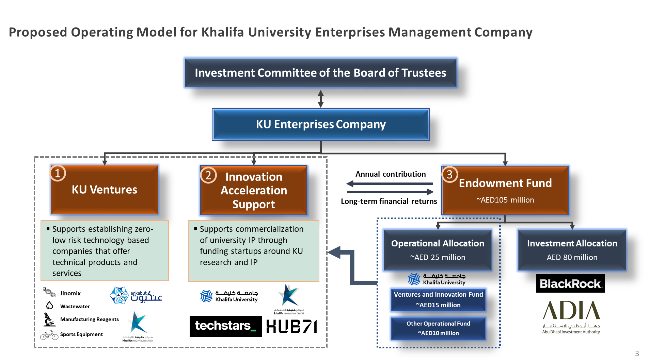

Slide 33
KUEC projects
Project Name: Establish Nava mask company and start sales.
Project involved departments: Research / Dr. Shadi
Project briefing:- to do an investment using KU patent in a new mask.
Project time frame: 2023
Project updates: a contract signed with Lavie company give them the right to use the IP, the company in the establishment stage.
Project amount: AED 2 to 3 million
Readiness of business plan: Yes internally
Expected ROI: 10%
Project Name: Develop Rassed - Covid19 detector and start manufacturing.
Project involved:
Project briefing:- Production of new Covid19 detector instrument .
Project time frame: 0.5-1 M
Project updates: still under feasibility stage.

Slide 34
KUEC projects
Project Name: Establish the bicycle company " KU - Bike" and start productions and sales.
Project involved departments: Aerospace department
Project briefing:- The fist UAE company
Project time frame: Dec 2022
Project updates: In the stage of establishing a new company in UAE.
Project amount: AED 1 to 2 million
Expected ROI: 20%-30%
Project Name: Establish " KU-Services" for renting KU labs and start activities.
Project involved: Facilities.
Project briefing:- To establish a sector of renting activities under KUEC.
Project time frame: Dec 2022
Project updates: To start preparation of the renting activities contract.
Project amount: AED .5 to 1 million
Expected ROI: 10%
Project Name: Establish KU advisory and start operation.
Project involved: Academic department
Project briefing:- To establish an advisory company.
Project time frame: Dec 2022
Project updates: under progress

Slide 35
KUEC projects
Project Name: Develop KUEC operating model and policies and procedures.
Project involved departments: BD
Project briefing:- Approving the propose interim policies and procedures and org. structure.
Project time frame: Dec 2022
Project updates: The committee requested to postpone till we finalize the authority matrix.
Project Name: Establish Waste water center.
Project involved : Chemistry Department
Project briefing:- To establish an analysis center for waste water.
Project time frame: 2023
Project updates: In the first stage of the donation and operation to specified gov. entities.
Project Name: Finalizing KUEC authority matrix.
Project involved: KUEC committee
Project briefing:- Approve the proposed authority matrix designed by Mr. Ebrahim
Project time frame: Dec 2022
Project updates: The new proposed POA under review my the KUEC leaders.

Slide 36
KUEC projects
Project Name: Establish PCR reagent company and increase sales.
Project involved : Biomedical department Dr. Habiba
Project briefing:- Manufacturing a reagent for PCR tests
Project time frame: Dec 2022
Project updates: KUEC committee rejected the proposal received from one of the companies in UAE, arranging a negotiation with Uni-lab.
Project amount: AED 2 to 3 million
Readiness of business plan: Yes internally
Expected ROI: 10%
Project Name: Automation of Administrative facilities rental project.
Project involved departments: BD / Facilities.
Project briefing:- To establish a full automated reservation / billing/payment solution.
Project time frame: April 2023
Project updates: under the fist stage of study.

Slide 37
KUEC projects
Project Name: Robotics for the maintenance of oil tanks project.
Project involved:- BD
Project briefing:- Opportunity to establish a company with one of UAE companies found a new concept of using robotics in cleaning vast oil containers.
Project time frame: 2023
Project updates: In the review of the concept stage
Project amount: AED .5 to 1 million
Expected ROI: 10%

Slide 38
